Slide 1

MOBILE PROGRAMMING
GROUP 9
DR. VALERY

Slide 2


Design And Implementation Of Database For
TripTrack
#Inovation@Triptrack

Slide 3









Database Requirements
Passenger
Interface
Driver
Interface
Destination Marker
Home Location Marker
Time Estimation
Route to Selected

Slide 4










Entity- Relationship
User
Driver
Location
Destination
Passenger

Slide 5
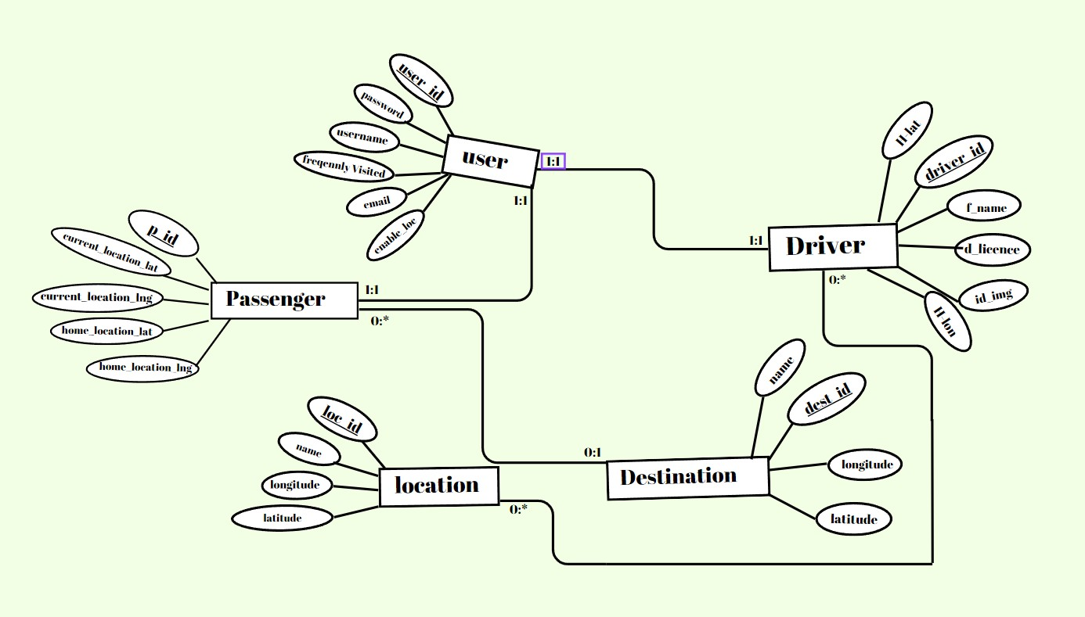
Entity-Relational Diagram

Slide 6







Database Design
Database Implementation
VSCODE
DESIGN DECITIONS
RELATIONSHIPS
CORE ENTITIES
DJANGO
POSTGRESSQL

Slide 7










Database Functionalities
Passengers Interface Functionality: Drivers Interface Functionality:
Adding Passengers Current Location Marker
Adding Passengers Current Location Marker
Setting Destination
Setting Destination
Tracing Location to Destination Route
Display Time and Distance To Selected Passengers Location
Add Passengers Home Location

Slide 8






Security & Authentication
User Authentication Role-Base Access control
Data Privacy
Secure Communication
Regular Security Adit

Slide 9
Testing & Performance
Testing Strategies:
Unit Comprehensive
Intergration
Performance

Slide 10

Testing & Performance
Performance Optimization:
Query performance
To
enhance
Query Optimization techniques
Database caching mechanism

Slide 11
CONCLUSION
In conclusion, the database design and implementation for the TripTrack system have been successful in meeting the system's requirements.
By following a well-structured approach, we have created a robust and efficient database that supports passenger and driver interfaces, including features like location tracking, route tracing, and user authentication.
The database has undergone rigorous testing to ensure data integrity, reliability, and optimal performance.

Slide 12

Thank y u!

